Slide 1
Strassen's Matrix Multiplication
Min Max Algorithm
Convex Hull

Slide 2

Basic Matrix Multiplication
Suppose we want to multiply two matrices of size N x N:
for example C = A x B .
The multiplication gives
C₁₁ = a₁₁b₁₁ + a₁₂b₂₁
C₁₂ = a₁₁b₁₂ + a₁₂b₂₂
C₂₁ = a₂₁b₁₁ + a₂₂b₂₁
C₂₂ = a₂₁b₁₂ + a₂₂b₂₂
2x2 matrix multiplication can be accomplished in 8 multiplication and 4 addition.(2^{log}₂⁸ =2³)

Slide 3
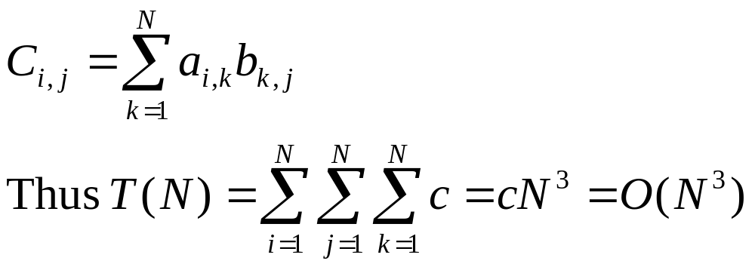
Basic Matrix Multiplication
void matrix_mult (){
for (i = 1; i <= N; i++) {
for (j = 1; j <= N; j++) { for(k =1; k<= N{
compute C_{i,j}; }}
}}
algorithm
Time analysis

Slide 4
Strassens’s Matrix Multiplication
Strassen showed that 2x2 matrix multiplication can be accomplished in 7 multiplications and 18 additions or subtractions. .(2^{log}₂⁷ =2^{2.807})
This reduce can be done by Divide and Conquer Approach.

Slide 5
Divide-and-Conquer
Divide-and conquer is a general algorithm design paradigm:
  Divide: divide the input data S in two or more disjoint subsets S₁, S₂, …
  Recur: solve the subproblems recursively
  Conquer: combine the solutions for S₁, S₂, …, into a solution for S
The base case for the recursion are subproblems of constant size
Analysis can be done using recurrence equations

Slide 6
Divide and Conquer Matrix Multiply
A × B = R
A₀ | A₁
A₂ | A₃
B₀ | B₁
B₂ | B₃
A₀×B₀+A₁×B₂ | A₀×B₁+A₁×B₃
A₂×B₀+A₃×B₂ | A₂×B₁+A₃×B₃
×
=
Divide matrices into sub-matrices: A₀ , A₁, A₂ etc
Use blocked matrix multiply equations
Recursively multiply sub-matrices

Slide 7
Divide and Conquer Matrix Multiply
A × B = R
a₀
b₀
a₀ × b₀
×
=
Terminate recursion with a simple base case

Slide 8
Strassens’s Matrix Multiplication
P₁ = (A₁₁+ A₂₂)(B₁₁+B₂₂)
P₂ = (A₂₁ + A₂₂) * B₁₁
P₃ = A₁₁ * (B₁₂ - B₂₂)
P₄ = A₂₂ * (B₂₁ - B₁₁)
P₅ = (A₁₁ + A₁₂) * B₂₂
P₆ = (A₂₁ - A₁₁) * (B₁₁ + B₁₂)
P₇ = (A₁₂ - A₂₂) * (B₂₁ + B₂₂)
C₁₁ = P₁ + P₄ - P₅ + P₇
C₁₂ = P₃ + P₅
C₂₁ = P₂ + P₄
C₂₂ = P₁ + P₃ - P₂ + P₆

Slide 9
Comparison
We can compare the traditional matrix multiplication procedure with Strassen’s procedure
C₁₁ = P₁ + P₄ - P₅ + P₇
= (A₁₁+ A₂₂)(B₁₁+B₂₂) + A₂₂ * (B₂₁ - B₁₁) - (A₁₁ + A₁₂) * B₂₂+
(A₁₂ - A₂₂) * (B₂₁ + B₂₂)
= A₁₁ B₁₁ + A₁₁ B₂₂ + A₂₂ B₁₁ + A₂₂ B₂₂ + A₂₂ B₂₁ – A₂₂ B₁₁ -
A₁₁ B₂₂ -A₁₂ B₂₂ + A₁₂ B₂₁ + A₁₂ B₂₂ – A₂₂ B₂₁ – A₂₂ B₂₂
= A₁₁ B₁₁ + A₁₂ B₂₁

Slide 10
Strassen Algorithm
void matmul(int *A, int *B, int *R, int n) {
if (n == 1) {
(*R) += (*A) * (*B);
} else {
matmul(A, B, R, n/4);
matmul(A, B+(n/4), R+(n/4), n/4);
matmul(A+2*(n/4), B, R+2*(n/4), n/4);
matmul(A+2*(n/4), B+(n/4), R+3*(n/4), n/4);
matmul(A+(n/4), B+2*(n/4), R, n/4);
matmul(A+(n/4), B+3*(n/4), R+(n/4), n/4);
matmul(A+3*(n/4), B+2*(n/4), R+2*(n/4), n/4);
matmul(A+3*(n/4), B+3*(n/4), R+3*(n/4), n/4);
}
Divide matrices in sub-matrices and recursively multiply sub-matrices

Slide 11
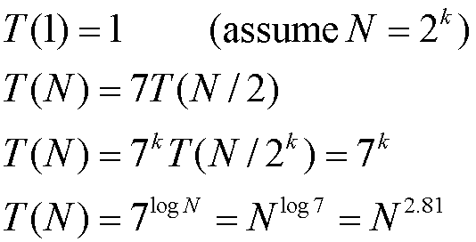
Time Analysis

Slide 12
Min and Max
The minimum of a set of elements:
  The first order statistic i = 1
The maximum of a set of elements:
  The n-th order statistic i = n
The median is the “halfway point” of the set
  i = (n+1)/2, is unique when n is odd
  i = ⎣(n+1)/2⎦ = n/2 (lower median) and ⎡(n+1)/2⎤ = n/2+1 (upper median), when n is even

Slide 13
Finding Minimum or Maximum
Alg.: MINIMUM(A, n)
min ← A[1]
for i ← 2 to n
do if min > A[i]
then min ← A[i]
return min
How many comparisons are needed?
  n – 1: each element, except the minimum, must be compared to a smaller element at least once
  The same number of comparisons are needed to find the maximum
  The algorithm is optimal with respect to the number of comparisons performed

Slide 14
Simultaneous Min, Max
Find min and max independently
  Use n – 1 comparisons for each ⇒ total of 2n – 2
At most 3n/2 comparisons are needed
  Process elements in pairs
  Maintain the minimum and maximum of elements seen so far
  Don’t compare each element to the minimum and maximum separately
  Compare the elements of a pair to each other
  Compare the larger element to the maximum so far, and compare the smaller element to the minimum so far
  This leads to only 3 comparisons for every 2 elements

Slide 15
Analysis of Simultaneous Min, Max
Setting up initial values:
  n is odd:
  n is even:
Total number of comparisons:
  n is odd: we do 3(n-1)/2 comparisons
  n is even: we do 1 initial comparison + 3(n-2)/2 more comparisons = 3n/2 - 2 comparisons
set both min and max to the first element
compare the first two elements, assign the smallest one to min and the largest one to max

Slide 16
Example: Simultaneous Min, Max
n = 5 (odd), array A = {2, 7, 1, 3, 4}
  Set min = max = 2
  Compare elements in pairs:
    1 < 7 ⇒ compare 1 with min and 7 with max ⇒ min = 1, max = 7
    3 < 4 ⇒ compare 3 with min and 4 with max ⇒ min = 1, max = 7
3 comparisons
3 comparisons
We performed: 3(n-1)/2 = 6 comparisons

Slide 17
Example: Simultaneous Min, Max
n = 6 (even), array A = {2, 5, 3, 7, 1, 4}
  Compare 2 with 5: 2 < 5
  Set min = 2, max = 5
  Compare elements in pairs:
    3 < 7 ⇒ compare 3 with min and 7 with max ⇒ min = 2, max = 7
    1 < 4 ⇒ compare 1 with min and 4 with max ⇒ min = 1, max = 7
1 comparison
3 comparisons
3 comparisons
We performed: 3n/2 - 2 = 7 comparisons

Slide 18
Convex Hulls

Slide 19
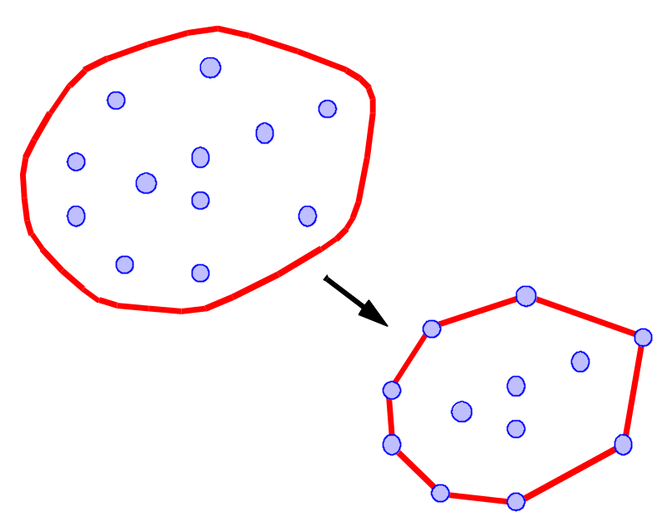
What is a Convex Hull?
Let S be a set of points in the plane.
Intuition: Imagine the points of S as being pegs; the convex hull of S is the shape of a rubber-band stretched around the pegs.
Formal definition: the convex hull of S is the smallest convex polygon that contains all the points of S.

Slide 20
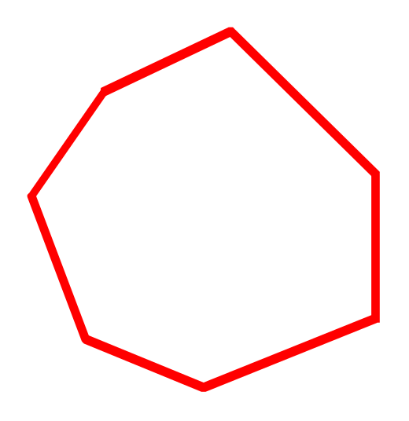

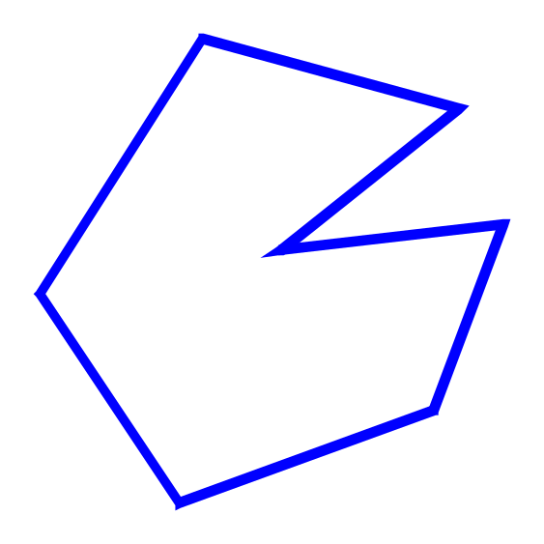
Convexity
convex
A polygon P is said to be convex if:
  P is non-intersecting; and
  for any two points p and q on the boundary of P, segment pq lies entirely inside P
Non convex

Slide 21
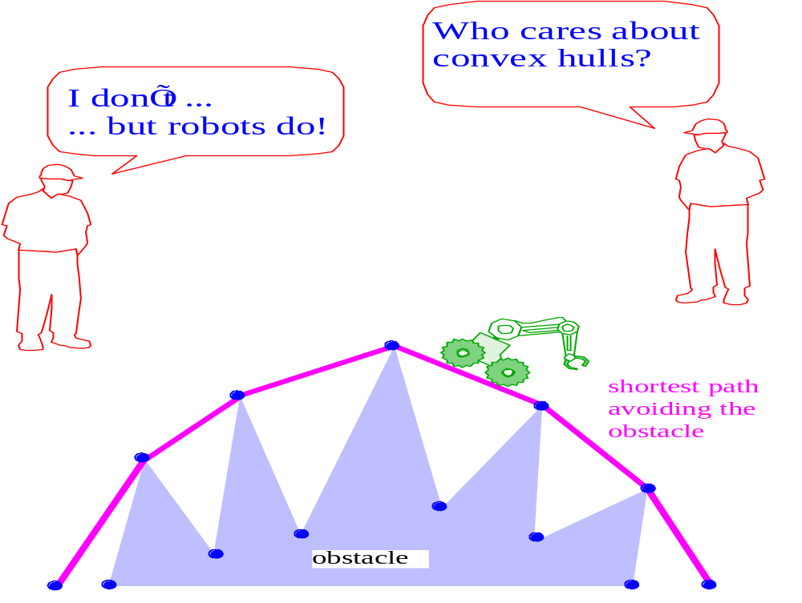
Why Convex Hulls?

Slide 22

The Package Wrapping Algorithm
Idea: Think of wrapping a package. Put the paper in contact with the package and continue to wrap around from one surface to the next until you get all the way around.

Slide 23
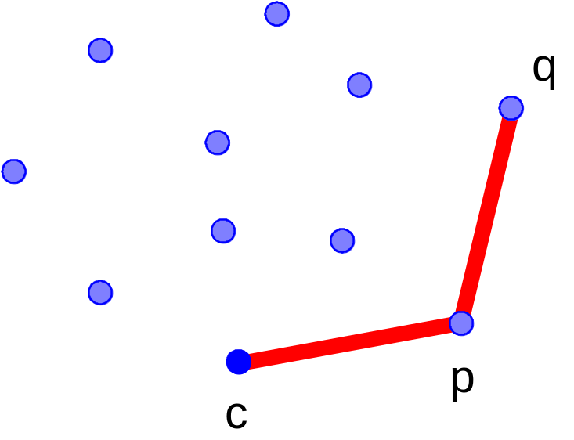
Package Wrap
Question: Given the current point, how do we compute the next point to be wrapped?
  Set up an orientation tournament using the current point as the anchor-point.
  The next point is selected as the point that beats all other points at CCW orientation, i.e., for any other point, we have orientation(c, p, q) = CCW

Slide 24
Time Complexity of Package Wrap
For every point on the hull we examine all the other points to determine the next point
Notation:
  N: number of points
  M: number of hull points (M ≤ N)
Time complexity: Θ(M N)
Worst case: Θ(N²)
  (All the points are on the hull, and thus M = N)
Average case: Θ(N log N ) — Θ(N^{4/3})
  for points randomly distributed inside a square, M = Θ(log N) on average
  for points randomly distributed inside a circle, M = Θ(N^{1/3}) on average

Slide 25
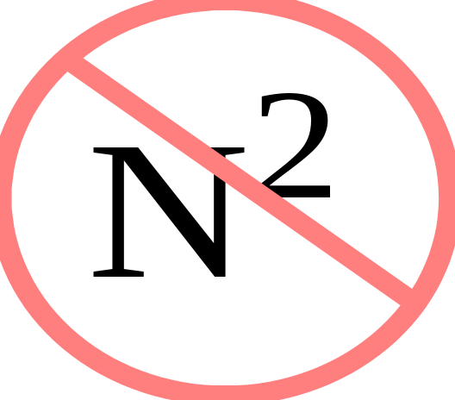
Package Wrap has worst-case time complexity O( N² )
Which is bad...
But in 1972, Nabisco needed a better cookie - so they hired R. L. Graham, who came up with...

Slide 26

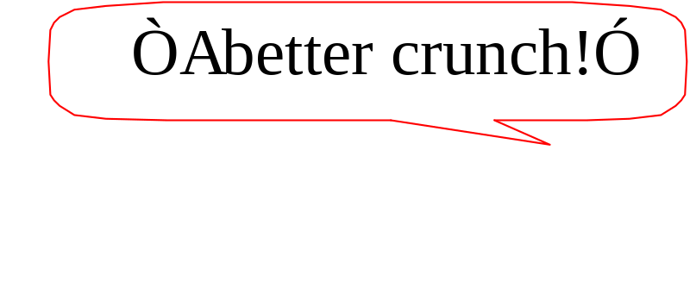
The Graham Scan Algorithm
Rave Reviews:
  “Almost linear!” Sedgewick
  “It’s just a sort!” Atul
  “Two thumbs up!” Siskel and Ebert
Nabisco says...
and history was made.

Slide 27
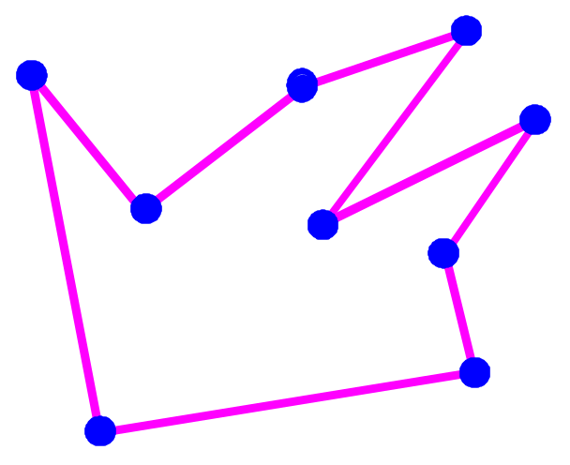
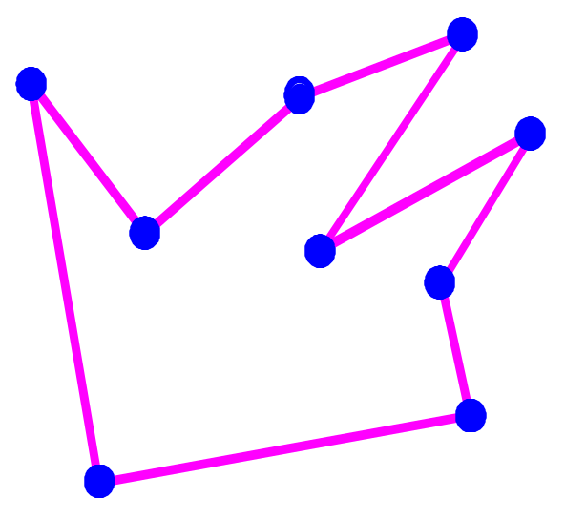
Graham Scan
Form a simple polygon (connect the dots as before)
Remove points at concave angles (one at a time, backtracking one step when any point is removed).
Continue until you get all the way around.

Slide 28
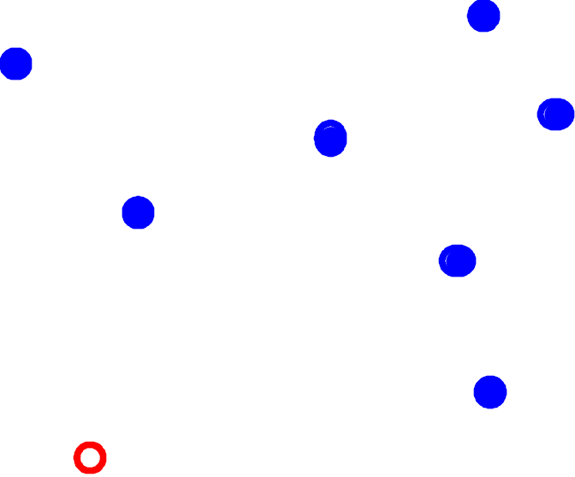
Graham Scan How Does it Work?
Start with the lowest point (anchor point)

Slide 29
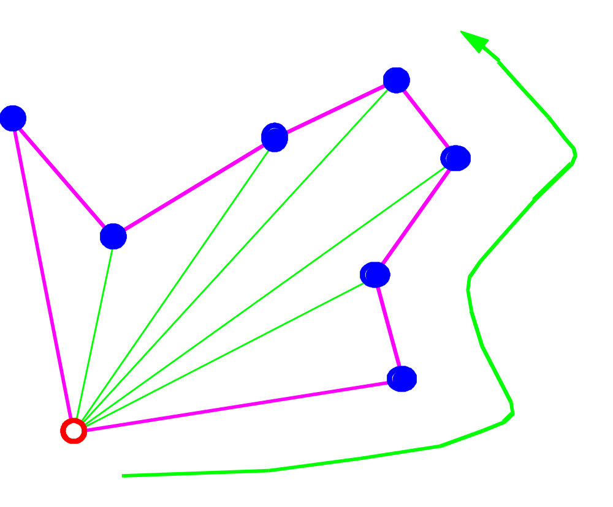
Graham Scan: Phase 1
Now, form a closed simple path traversing the points by increasing angle with respect to the anchor point

Slide 30
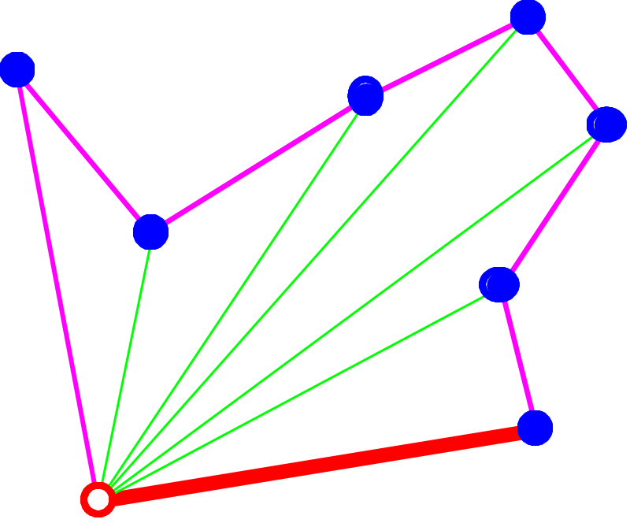
Graham Scan: Phase 2
The anchor point and the next point on the path must be on the hull

Slide 31
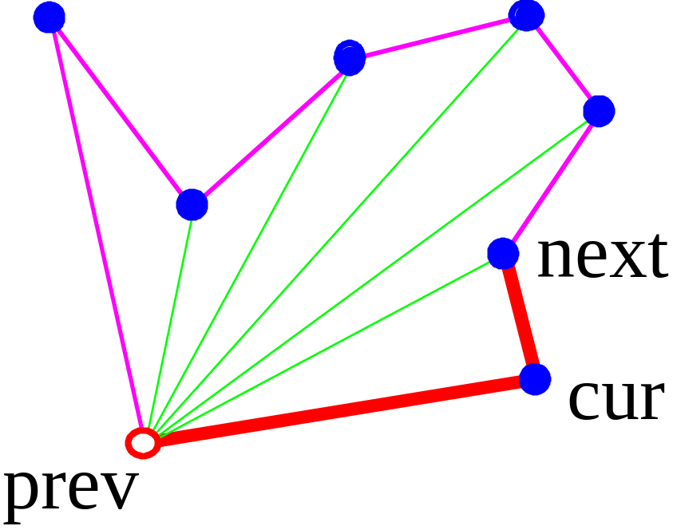
Graham Scan: Phase 2
keep the path and the hull points in two sequences
  elements are removed from the beginning of the path sequence and are inserted and deleted from the end of the hull sequence
orientation is used to decide whether to accept or reject the next point

Slide 32
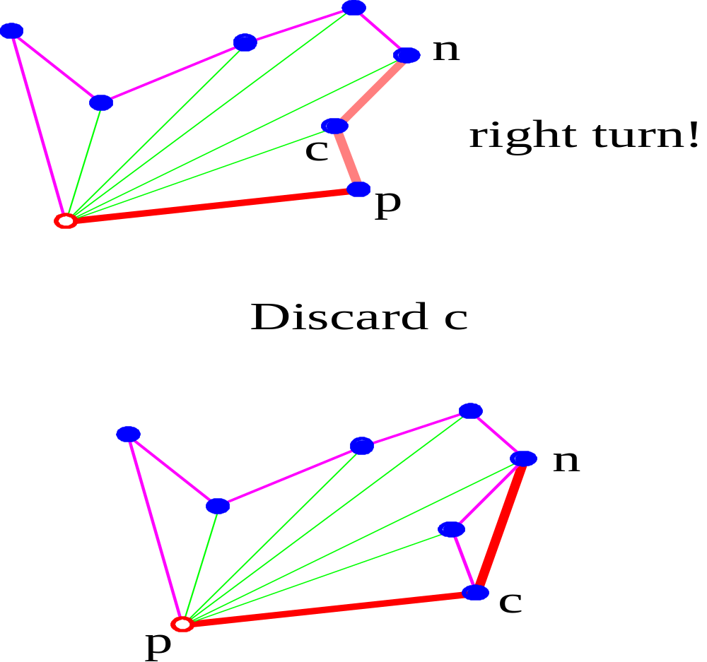
(p,c,n) is a

Slide 33
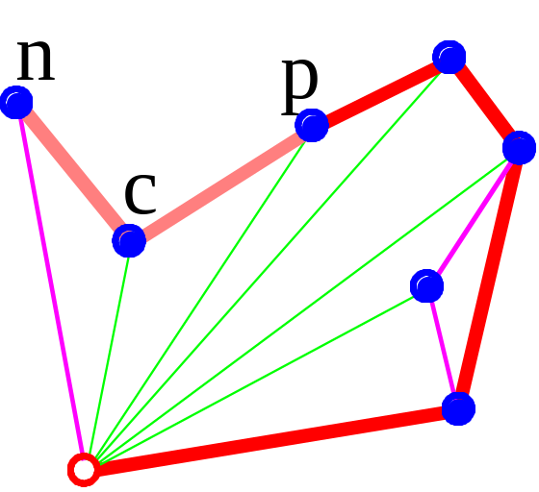
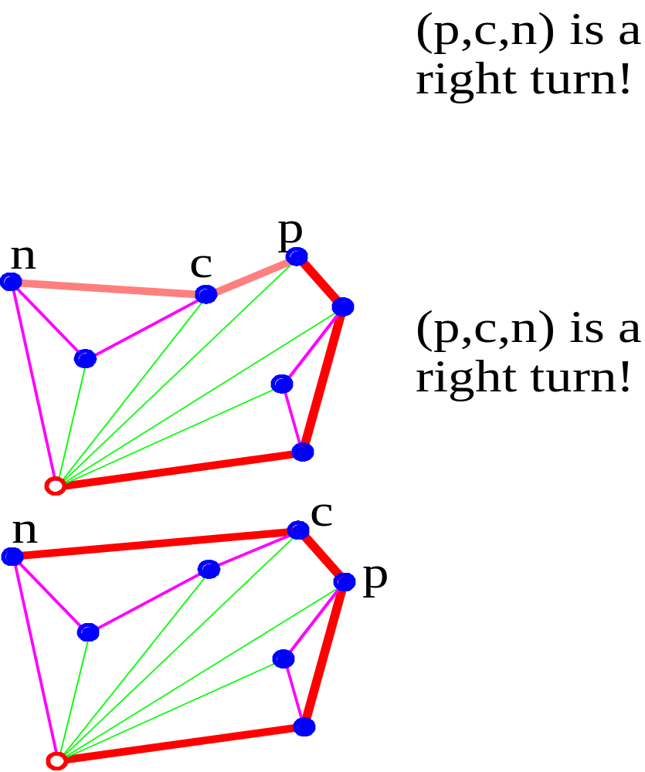

Slide 34
Time Complexity of Graham Scan
Phase 1 takes time O(N logN)
  points are sorted by angle around the anchor
Phase 2 takes time O(N)
  each point is inserted into the sequencen exactly once, and each point is removed from the sequence at most once
Total time complexity O(N log N)

